Slide 1
Bresenham Circle Generation
Algorithm

Slide 2
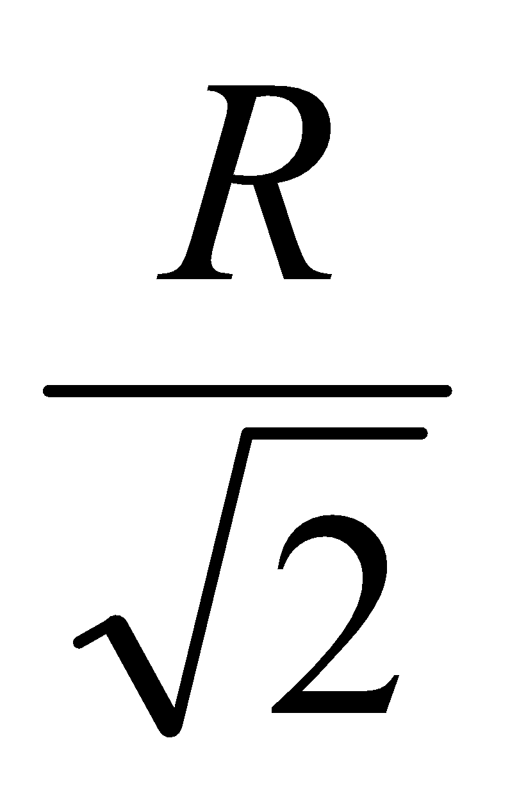
8- point symmetry in circles
(-x, y)
(x, y)
(-y, x)
(y, x)
(-y, -x)
(y, -x)
(-x, -y)
(x, -y)

Slide 3
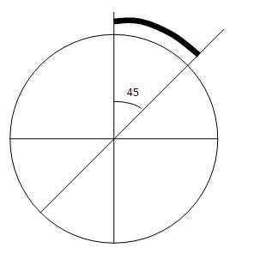
Concept
Circles have the property of being highly symmetrical, which is handy when it comes to drawing them on a display screen.
We know that there are 360 degrees in a circle. First we see that a circle is symmetrical about the x axis, so only the first 180 degrees need to be calculated.
Next, we see that it's also symmetrical about the y axis, so now we only need to calculate the first 90 degrees. Finally, we see that the circle is also symmetrical about the 45 degree diagonal axis, so we only need to calculate the first 45 degrees.

Slide 4
Interpolation
Bresenham's circle algorithm calculates the locations of the pixels in the first 45 degrees. It assumes that the circle is centered on the origin shifting the original center coordinates (centerx , centery). So for every pixel (x,y) it calculates, we draw a pixel in each of the 8 octants of the circle :
putpixel(centerx + x, center y + y) putpixel(centerx + x, center y - y) putpixel(centerx - x, center y + y) putpixel(centerx - x, center y - y) putpixel(centerx + y, center y + x) putpixel(centerx + y, center y - x) putpixel(centerx - y, center y + x) putpixel(centerx - y, center y - x)

Slide 5
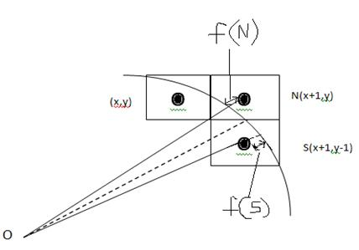
Derivation
Now, consider a very small continuous arc of the circle interpolated below, passing by the discrete pixels as shown.
At any point (x,y),
we have two choices –
Choose the pixel on east of it
N(x+1,y)
S(x+1,y-1).
determine the errors involved with both N & S which are f(N) and f(S) respectively and whichever gives the lesser error, we choose that pixel.

Slide 6
Let d_{i} = f(N) + f(S), where d can be called as "decision parameter", so that
if (d_{i}<=0), then, N(x+1,y) is to be chosen as next pixel
i.e. x_{i+1} = x_{i}+1 and y_{i+1} = y_{i}, and if (d_{i}>0), then, S(x+1,y-1) is to be chosen as next pixel
i.e. x_{i+1} = x_{i}+1 and y_{i+1} = y_{i}-1.
We know that for a circle, x² + y² = r²,
where r represents the radius of the circle, an input to the algorithm. Errors can be represented as f(N) = (x_{i} + 1)² + y_{i}² - r², -(1) f(S) = (x_{i} + 1)² + (y_{i} - 1)² - r² -(2) As d_{i} = f(N) + f(S), d_{i} = 2(x_{i}+1)² + y_{i}² + (y_{i}-1)² – 2r² -(3)

Slide 7
Calculating next decision parameter, d_{i+1} = 2(x_{i}+2)² + y_{i+1}² + (y_{i+1}-1)² – 2r² -(4) from (4)- (3), we get, d_{i+1} – d_{i} = 2((x_{i}+2)²-(x_{i}+1)²) + (y_{i+1}² – y_{i}²) + ((y_{i+1}-1)² - (y_{i}-1)²) d_{i+1} = d_{i} + 2(2x_{i}+3) + ((y_{i+1}+y_{i})(y_{i+1}-y_{i})) + ((y_{i+1}-1+y_{i}-1)(y_{i+1}-1-y_{i}+1))

Slide 8
Now, if (d_{i}<=0), x_{i+1}=x_{i}+1 and y_{i+1}=y_{i}
so that d_{i+1} = d_{i} + 2(2x_{i} + 3) + ((y_{i+1}+y_{i})( y_{i}-y_{i})) + ((y_{i}-1+y_{i}-1)(y_{i}-1-y_{i}+1)) d_{i+1} = d_{i} + 2(2x_{i} + 3) + ((y_{i+1}+y_{i})(0)) + ((y_{i}-1+y_{i}-1)(0)) d_{i+1} = d_{i} + 4x_{i} + 6

Slide 9
Else (d_{i} >0)
d_{i+1} = d_{i} + 2(2x_{i}+3) + ((y_{i}-1+y_{i})(y_{i}-1-y_{i})) + ((y_{i}-2+y_{i}-1)(y_{i}-2-y_{i}+1)) d_{i+1} = d_{i} + 4x_{i}+6 + ((2y_{i}-1)(-1)) + ((2y_{i}-3)(-1)) d_{i+1} = d_{i} + 4x_{i}+6 - 2y_{i} - 2y_{i} + 1 + 3 d_{i+1} = d_{i} + 4(x_{i} - y_{i}) + 10

Slide 10
To know d_{i+1}, we have to know d_{i} first.
The initial value of d_{i} can be obtained by replacing x=0 and y=r in (3).
Thus, we get,
d_{o} = 2 + r² + (r - 1)² -2r² d_{o} = 2 + r² + r² + 1 -2r – 2r² d_{o} = 3 – 2r

Slide 11
BRESENHAM’S CIRCLE ALGORITHM
Bresenham Circle ( Xc, Yc, R):
Description: Here Xc and Yc denote the x – coordinate and y –coordinate of the center of the circle. R is the radius.
1. Set X = 0 and Y = R
2. Set D = 3 – 2R
3. Repeat While (X <= Y)
4. Call Draw Circle(Xc, Yc, X, Y)
5. Set X = X + 1
6. If (D < 0) Then
7. D = D + 4X + 6
8. Else
9. Set Y = Y – 1
10. D = D + 4(X – Y) + 10
[End of If]
Call Draw Circle(Xc, Yc, X, Y)
X++
[End of While]
11. Exit

Slide 12
Draw Circle (Xc, Yc, X, Y):
1. Call PutPixel(Xc + X, Yc, + Y)
2. Call PutPixel(Xc - X, Yc, + Y)
3. Call PutPixel(Xc + X, Yc, - Y)
4. Call PutPixel(Xc - X, Yc, - Y)
5. Call PutPixel(Xc + Y, Yc, + X)
6. Call PutPixel(Xc - Y, Yc, + X)
7. Call PutPixel(Xc + Y, Yc, - X)
8. Call PutPixel(Xc - Y, Yc, - X)
9. Exit

Slide 13
Example
r = 10
p₀ = 3 – 2r = -17
Initial point (x₀, y₀) = (0, 10)
10 | ■ | ■ | ■ | ■
9 |  |  |  |  | ■ | ■
8 |  |  |  |  |  |  | ■
7 |  |  |  |  |  |  |  | ■
6 |  |  |  |  |  |  |  |  | ■
5 |  |  |  |  |  |  |  |  |  | ■
4 |  |  |  |  |  |  |  |  |  | ■
3 |  |  |  |  |  |  |  |  |  |  | ■
2 |  |  |  |  |  |  |  |  |  |  | ■
1 |  |  |  |  |  |  |  |  |  |  | ■
0 |  |  |  |  |  |  |  |  |  |  | ■
 | 0 | 1 | 2 | 3 | 4 | 5 | 6 | 7 | 8 | 9 | 10
i | p_{i} | x_{i}, y_{i}
0 | -17 | (0, 10)
1 | -11 | (1, 10)
2 | -1 | (2, 10)
3 | 13 | (3, 10)
4 | -5 | (4, 9)
5 | 15 | (5, 9)
6 | 9 | (6, 8)
7 |  | (7,7)

